Slide 1

Calculating infrared spectra using computational quantum chemistry
WebMO Tutorial

Slide 2
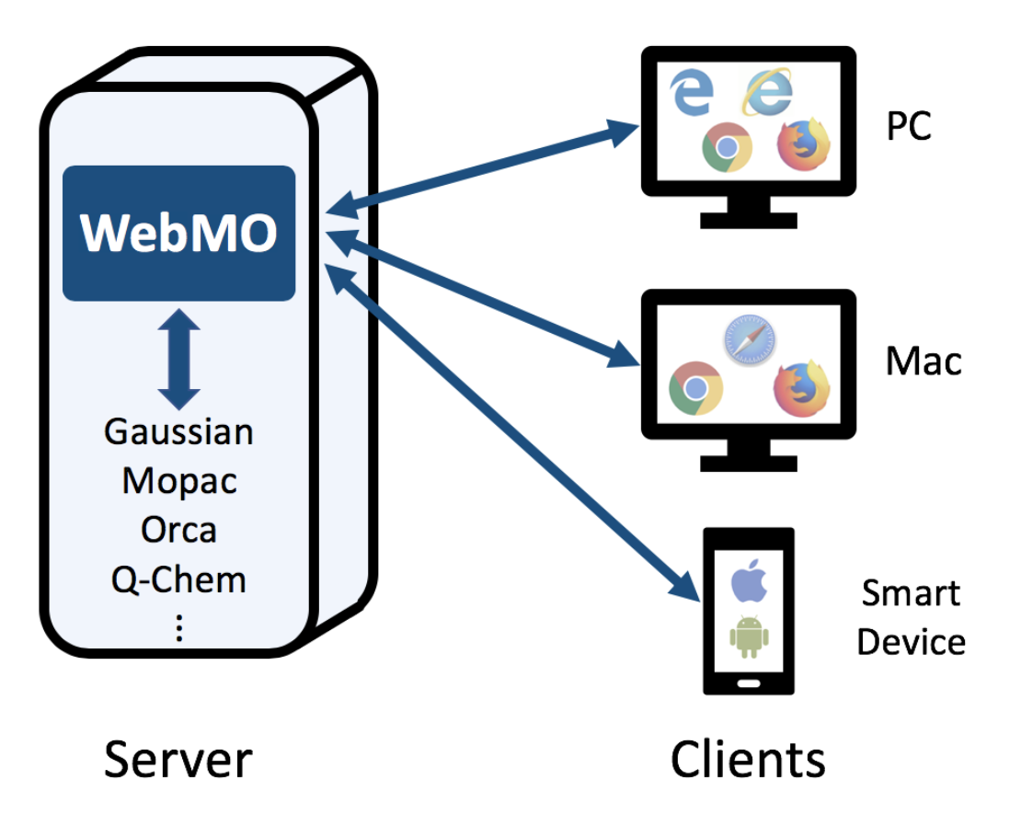
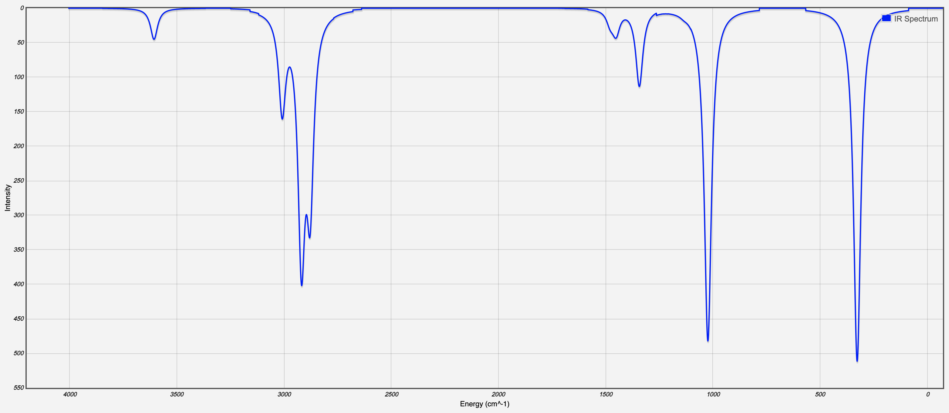
What is WebMO?
WebMO is a web-based interface to computational chemistry packages.
Computer programs storing all the mathematical formalisms behind quantum chemistry calculations

Slide 3
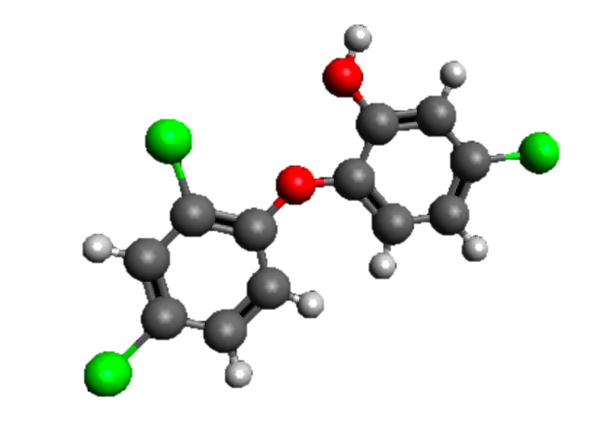
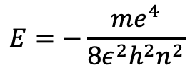
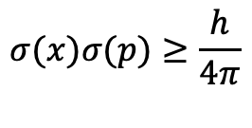
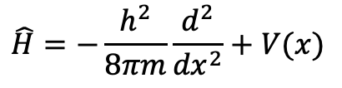
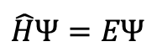
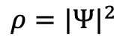
The basics of a quantum chemistry calculation
$$\hat{H}=−\frac{h^{2}}{8πm}\frac{d^{2}}{{dx}^{2}}+V(x)$$
$$ρ={|Ψ|}^{2}$$
$$σ(x)σ(p)≥\frac{h}{4π}$$
$$\hat{H}Ψ=EΨ$$
$$E=−\frac{{me}^{4}}{8ε^{2}h^{2}n^{2}}$$
Geometry
Method
Basis set
Spatial position of all atoms in a molecule
Approximations used to solve the equations
Representation of electrons

Slide 4
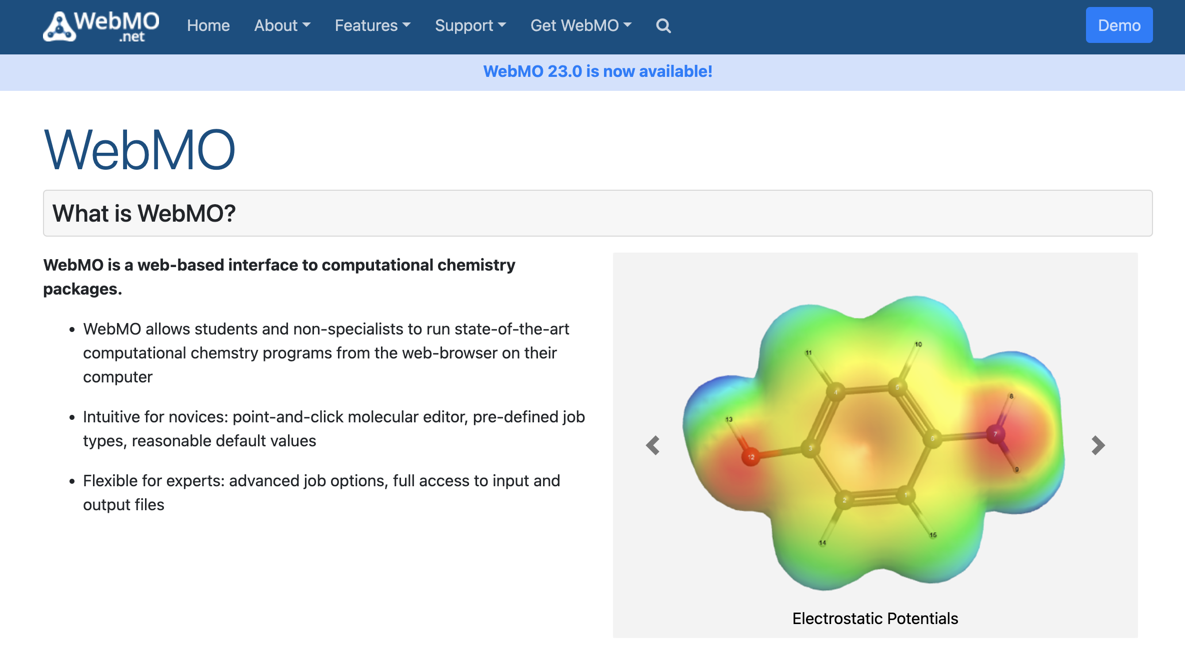
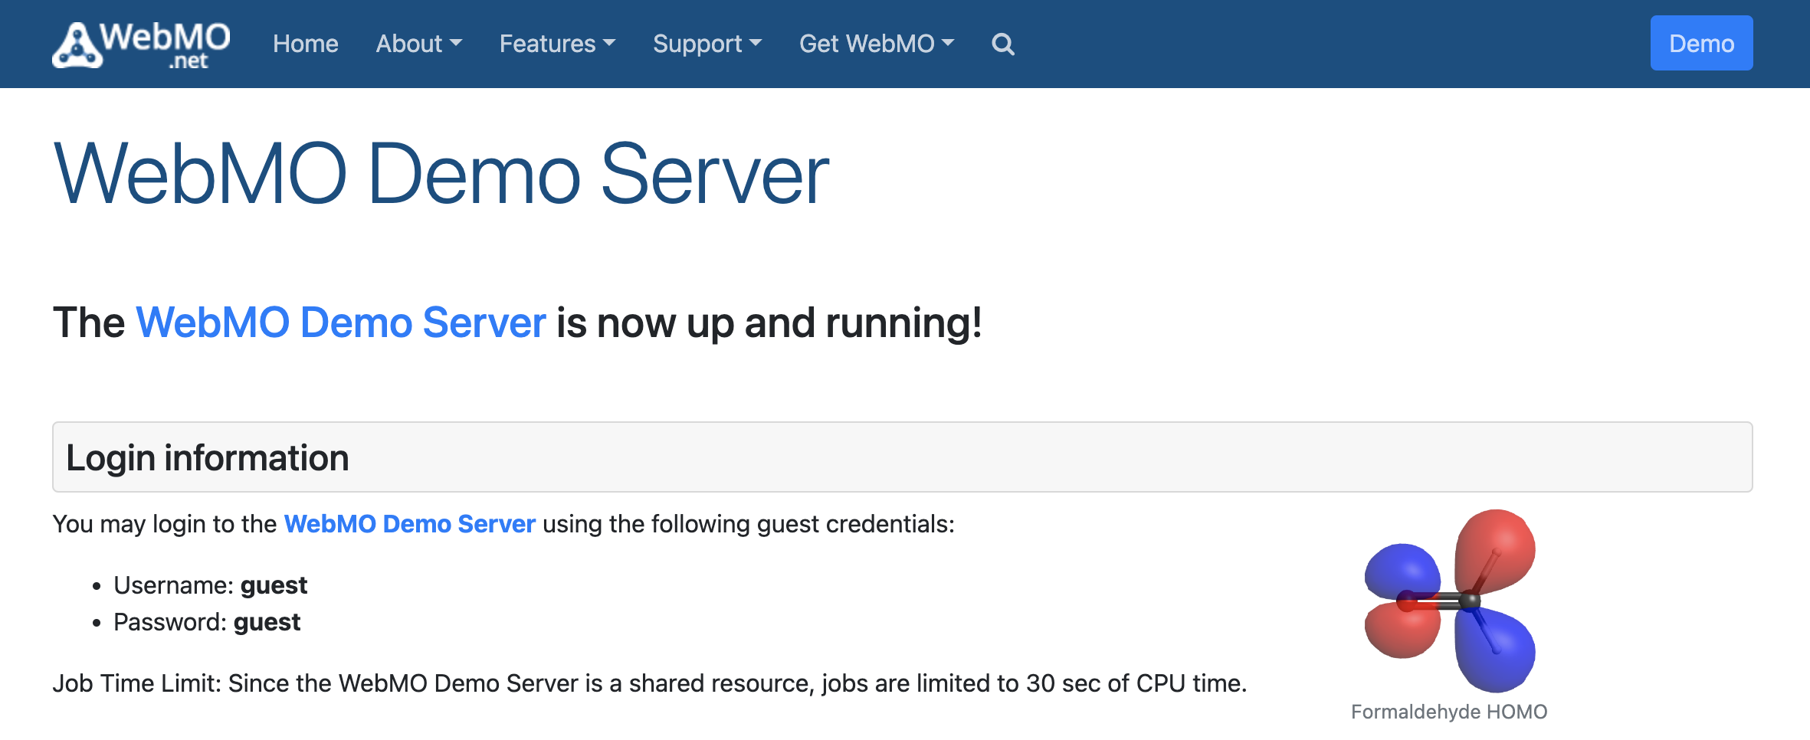
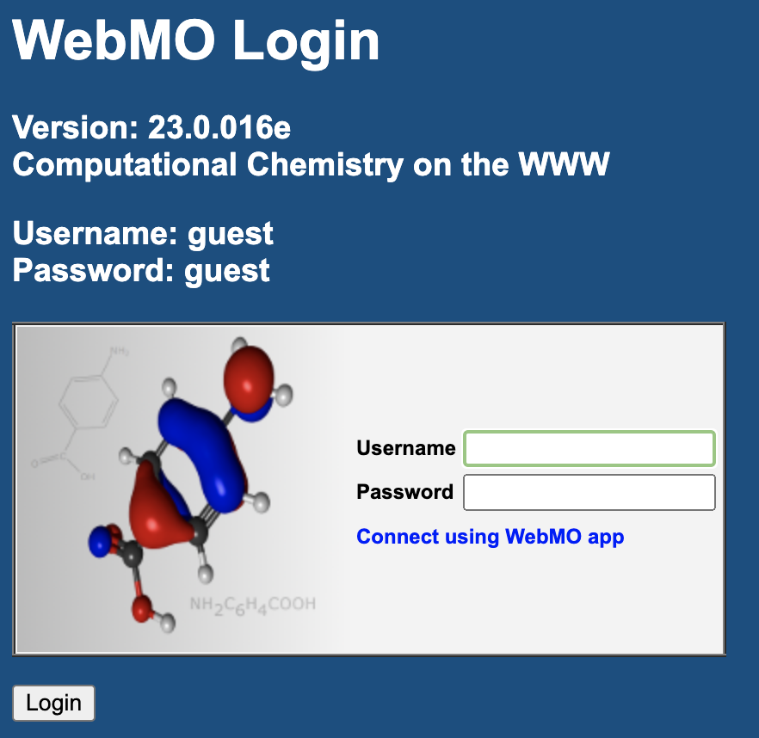
Getting started
Go to https://www.webmo.net and follow the Demo prompts until you get to the WebMO Login page

Slide 5
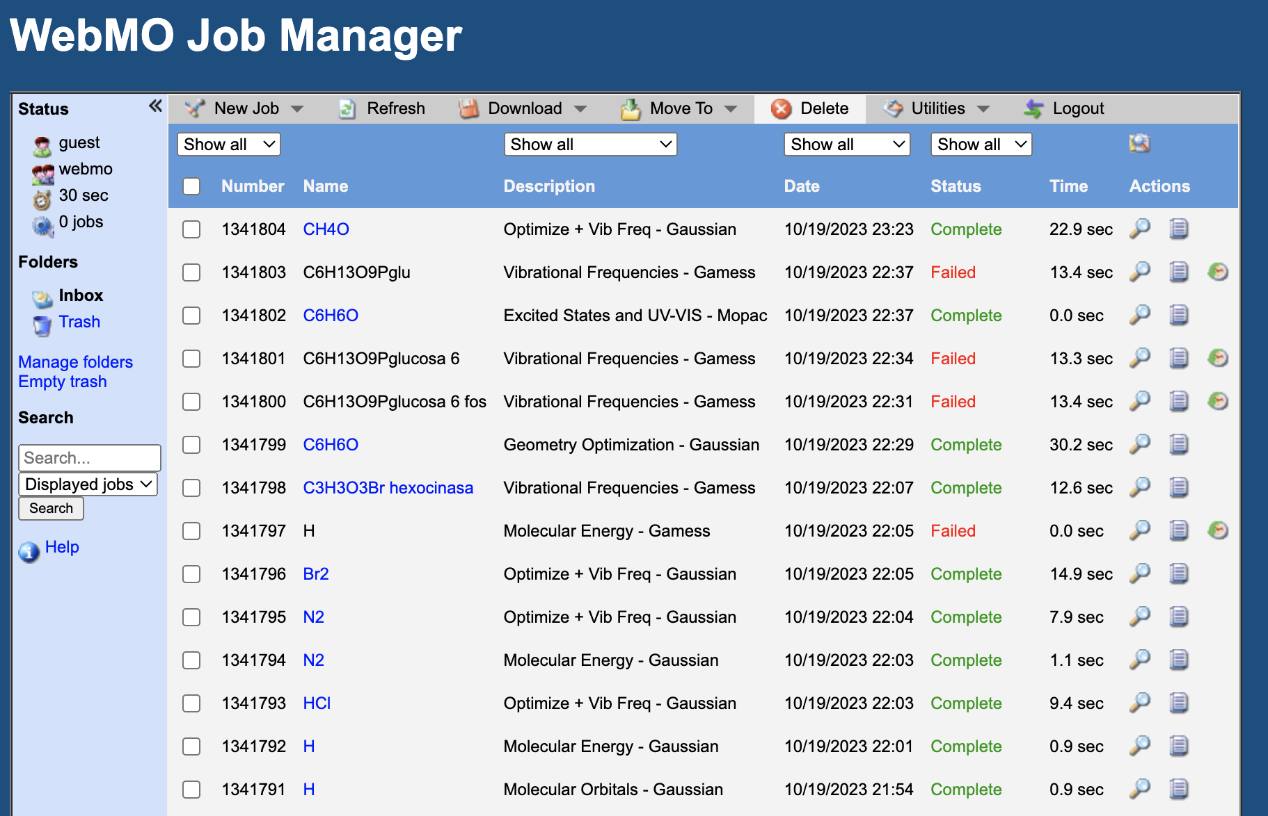

WebMO Job Manager page
Create a new job
Panel showing all jobs running. Note the Name, Description and Status columns

Slide 6
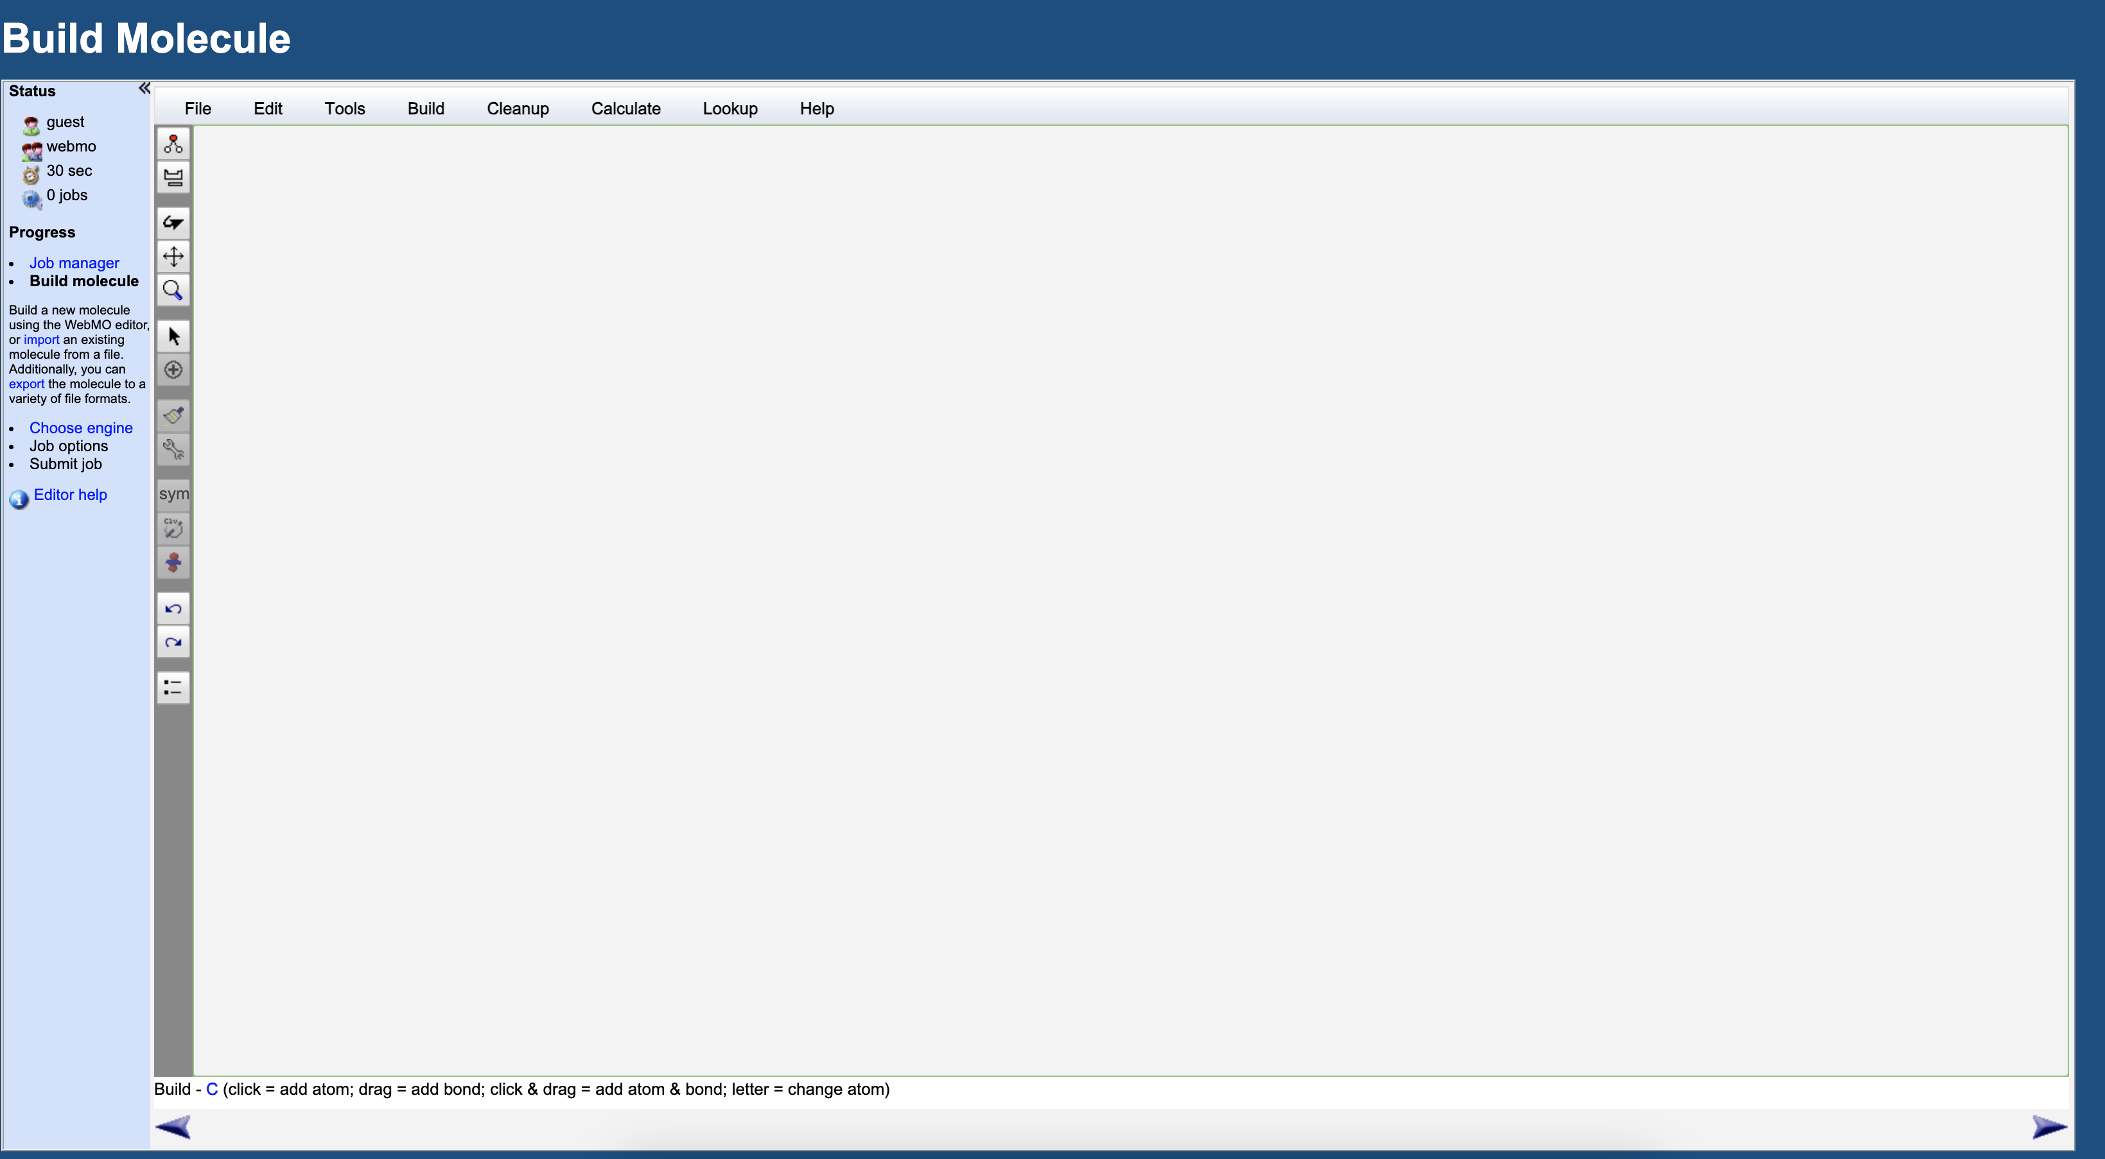
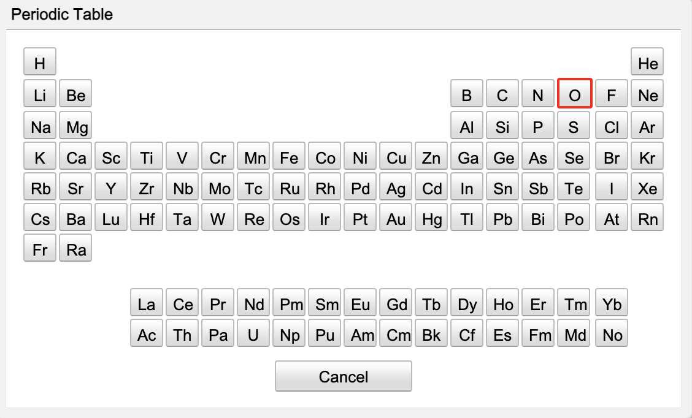
Drawing a molecule (H₂O)
Click in the periodic table icon to choose the elements for your molecule.
Draw a H₂O molecule by clicking on the O atom and then adding the Hs (drag them from the O atom outwards)

Slide 7
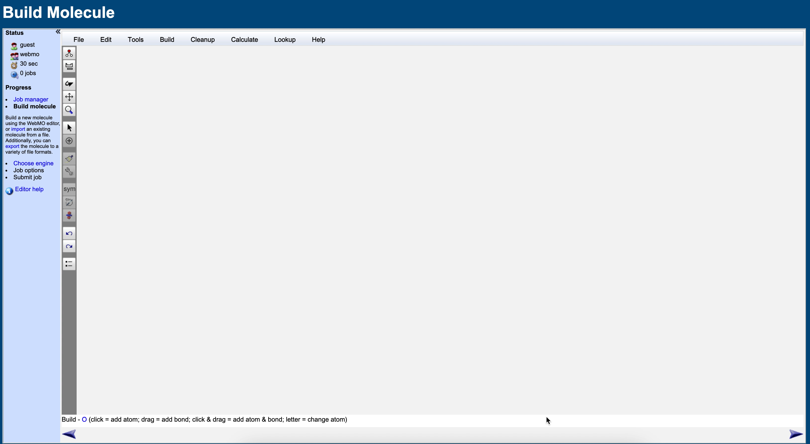
Drawing a molecule (H₂O)
Click in the periodic table icon to choose the elements for your molecule.
Draw a H₂O molecule by clicking on the O atom and then adding the Hs (drag them from the O atom outwards)

Slide 8
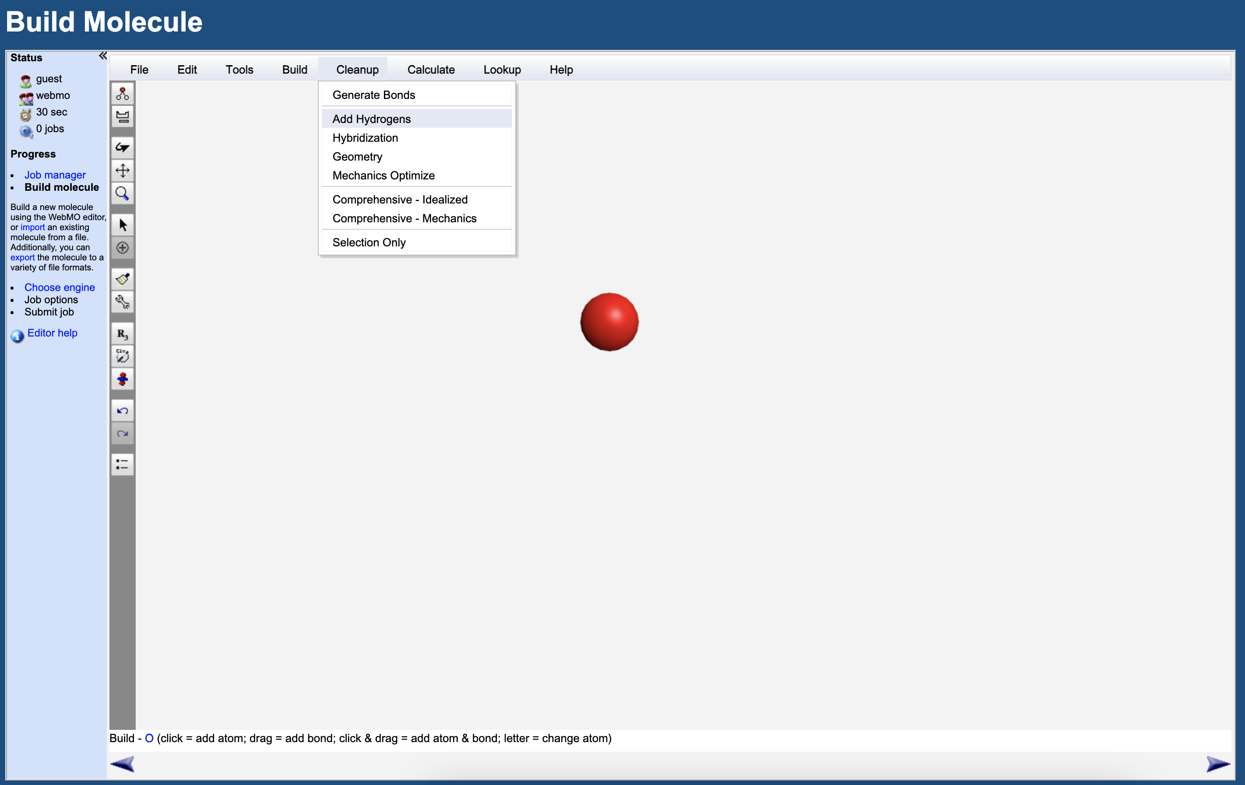
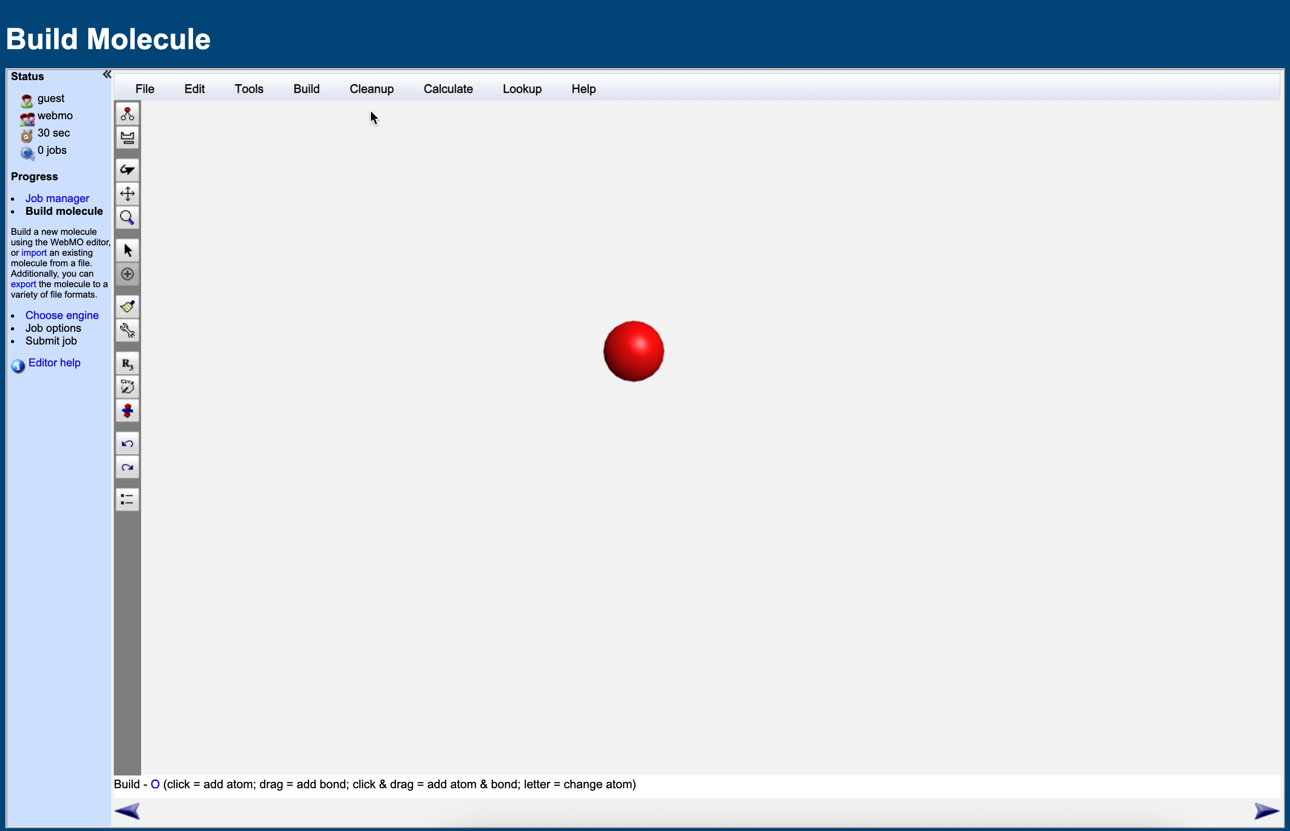
Drawing a molecule (H₂O)
You can also add Hs by clicking Cleanup -> Add Hydrogens

Slide 9
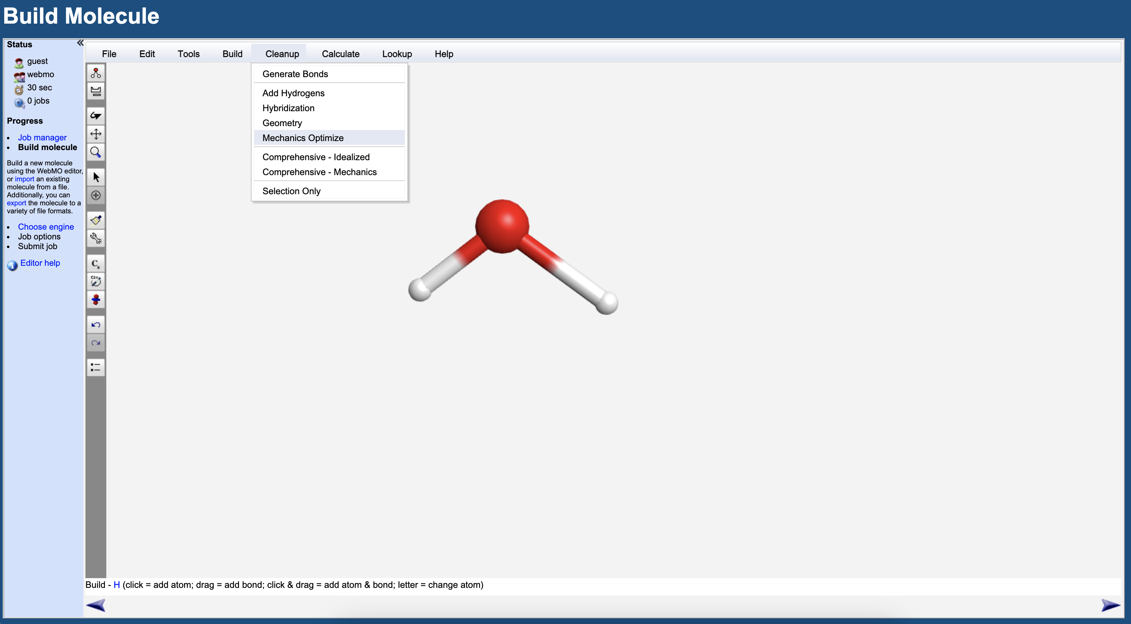
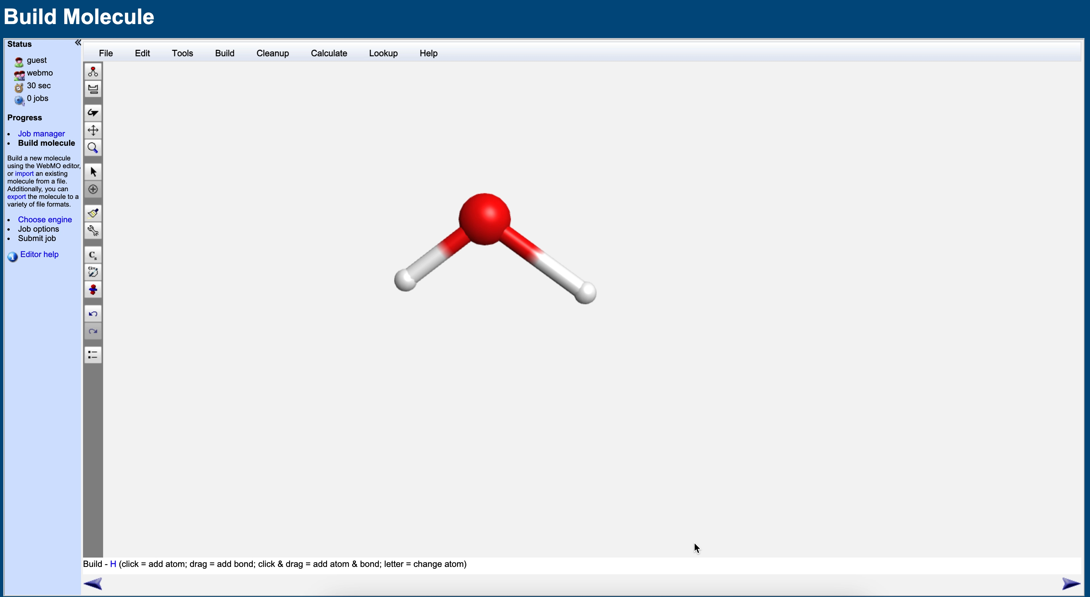
Geometry optimisation
Provide a crude geometry optimisation by clicking Cleanup -> Mechanics Optimize

Slide 10
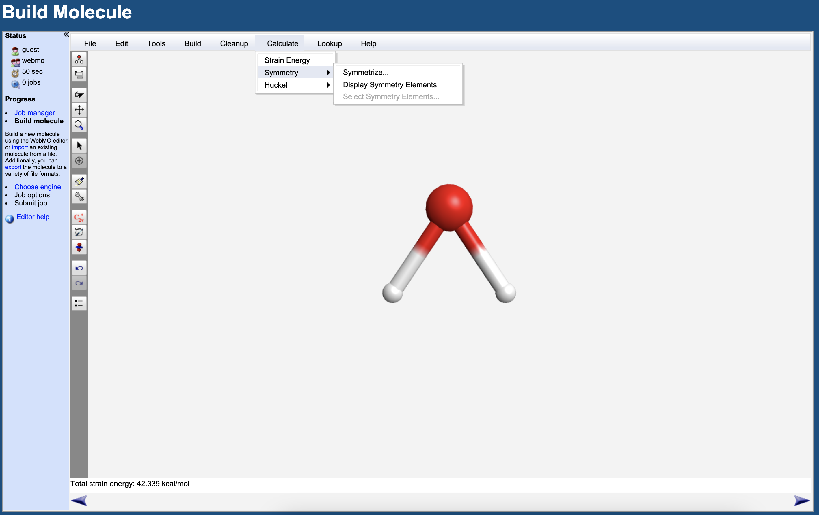
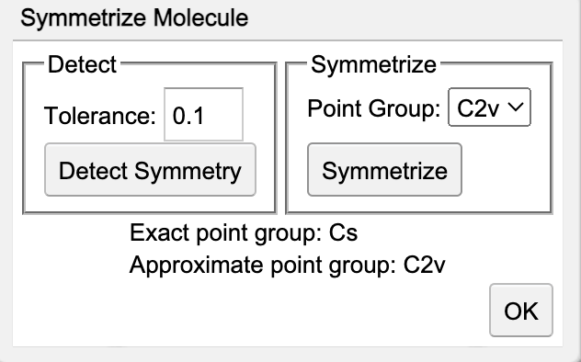
Symmetrise the molecule
Symmetrise the molecule by clicking Calculate -> Symmetry -> Symmetrize…
The “Symmetrize Molecule” window will show up. Click Symmetrize and then OK

Slide 11
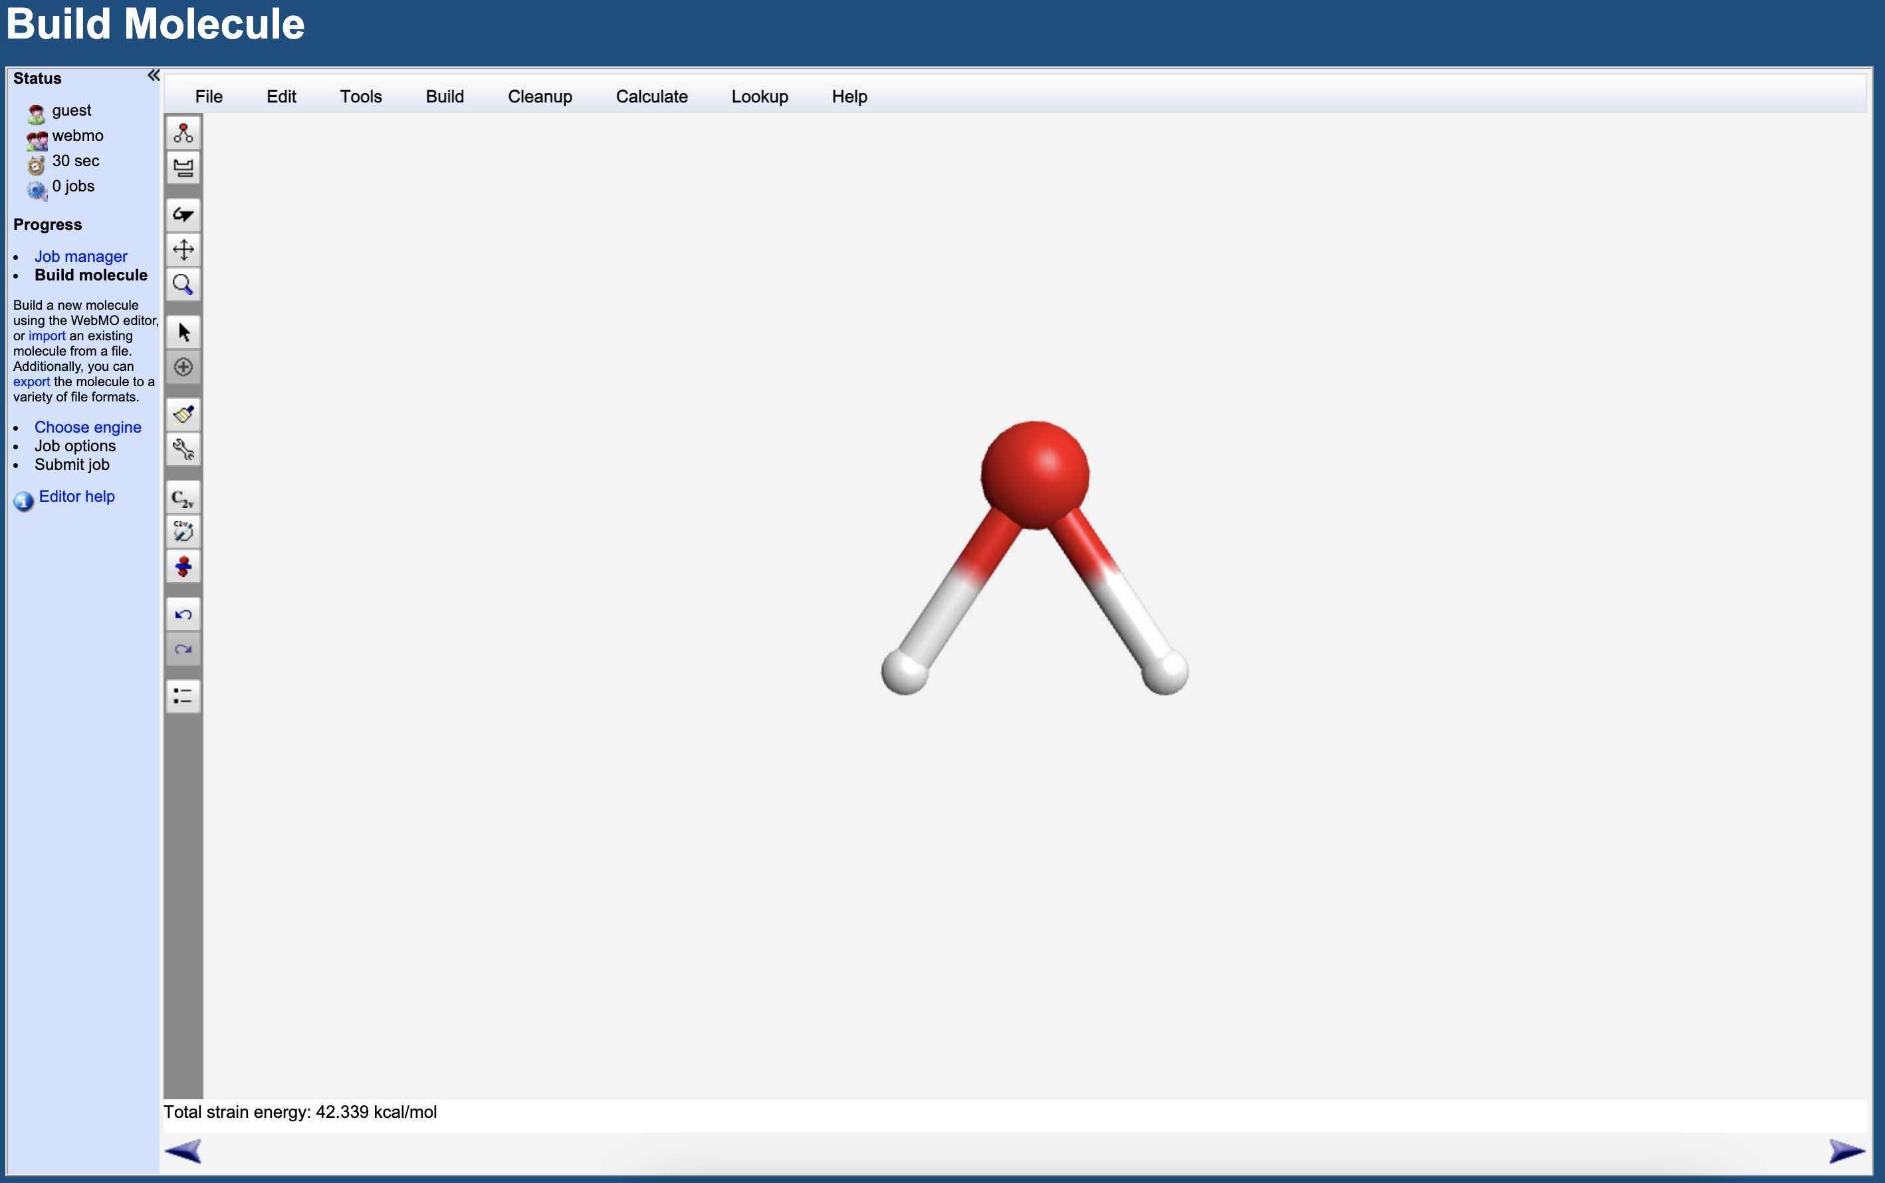
Setting up the calculation
Once you have performed the crude geometry optimisation and symmetrised the molecule, click on the right purple arrow to continue with the calculations setting

Slide 12
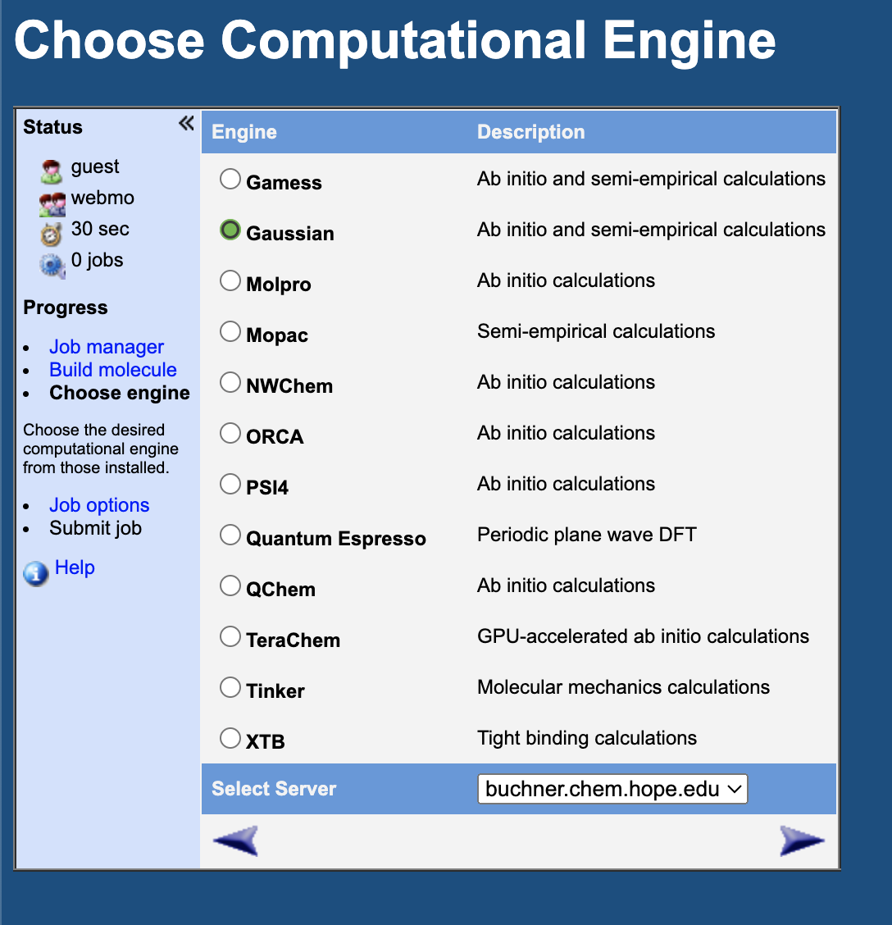
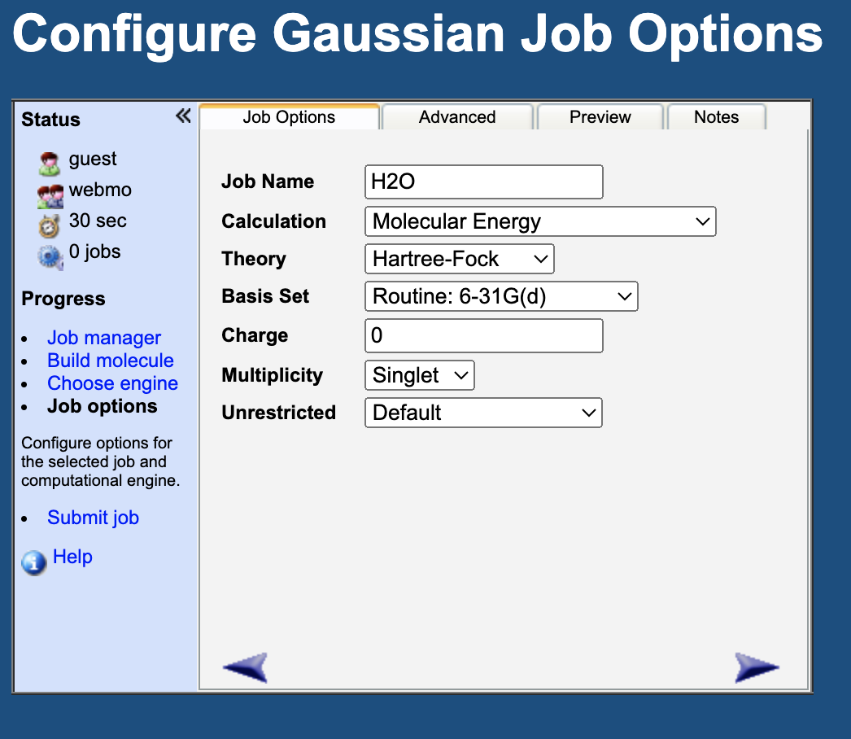
Setting up the calculation
Choose the Gaussian program and click the right purple arrow
Job name (make sure you name it properly!)
Choose Optimize + Vib Freq
Choose Hartee-Fock
Choose
6-31G(d)

Slide 13
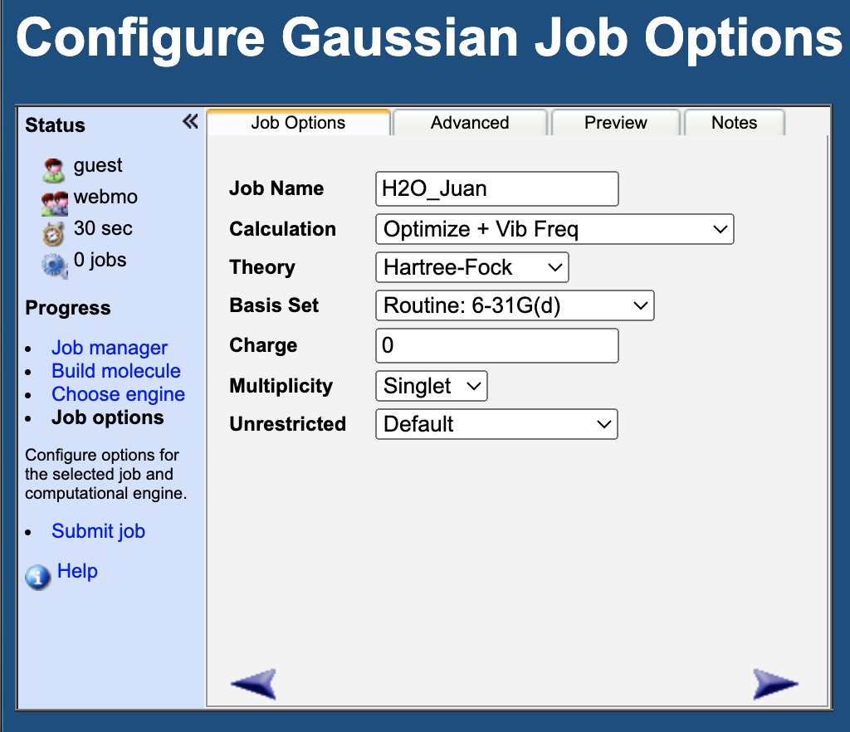
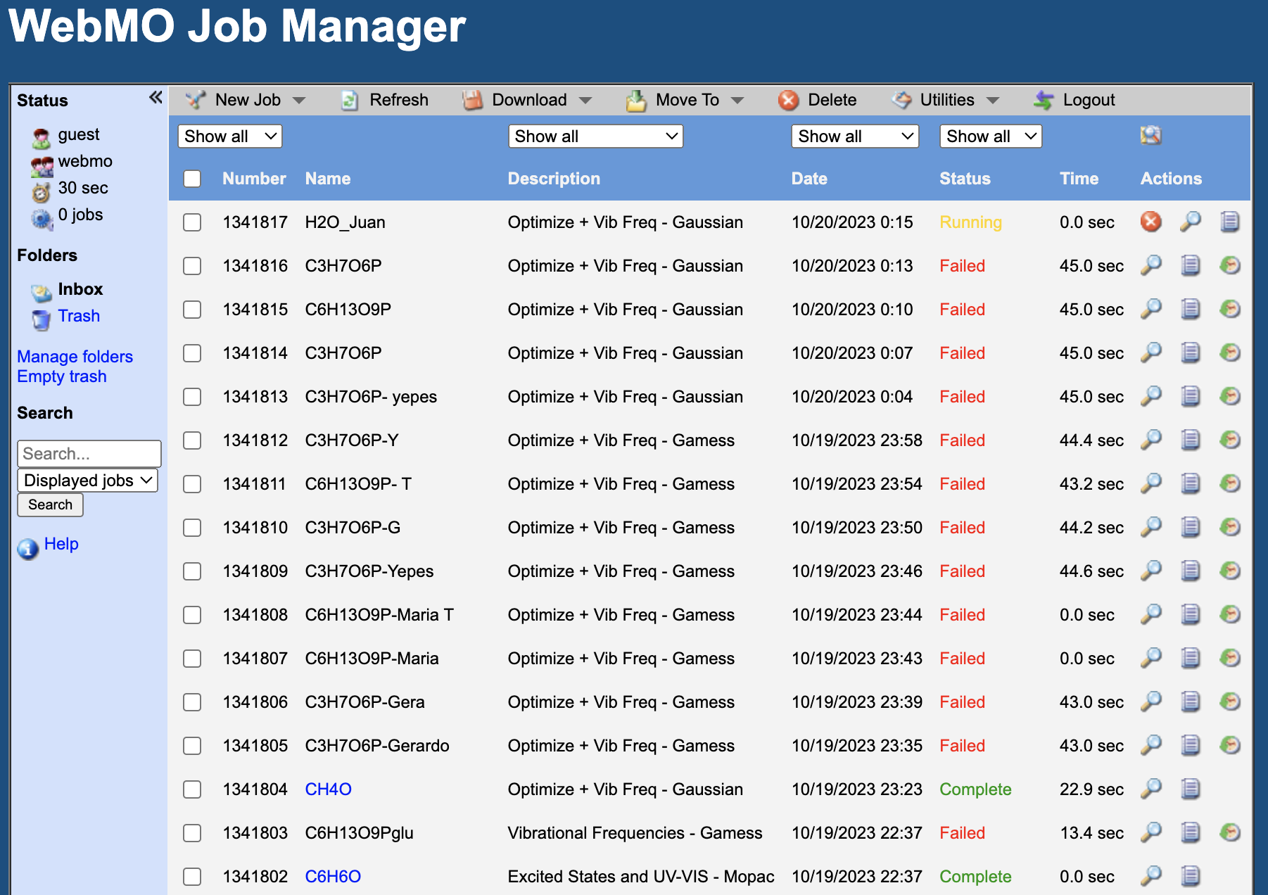
Running your calculation
At the WebMO Job Manager page you can follow your calculation
Your job will be done when the Status column says Complete
Click on the purple right arrow to continue

Slide 14
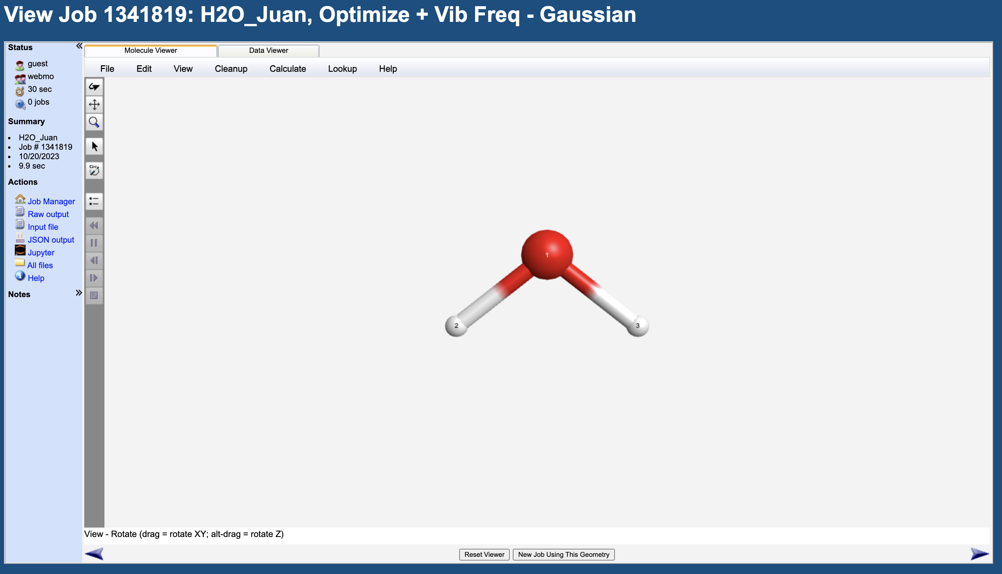
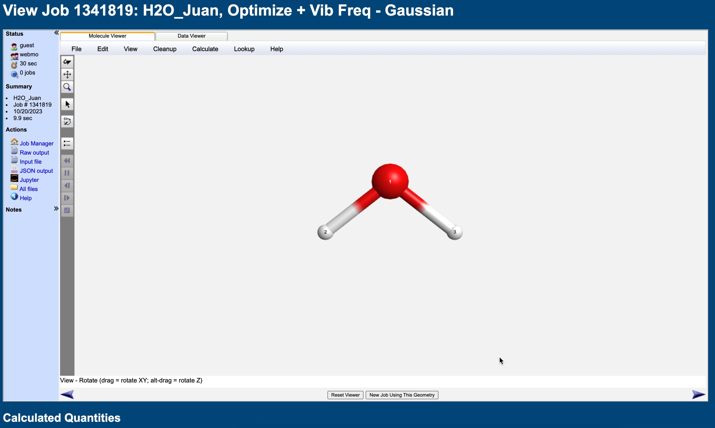
Looking at the data
Once your calculation has finished, click on your calculations name to see the results
You’ll see a page like this one. Note that the name of your calculation is at the top. Also note that the geometry looks different to the initial one!
Scroll to the bottom of the page to the section that says Vibrational Modes. Here you’ll find the infrared spectrum data

Slide 15

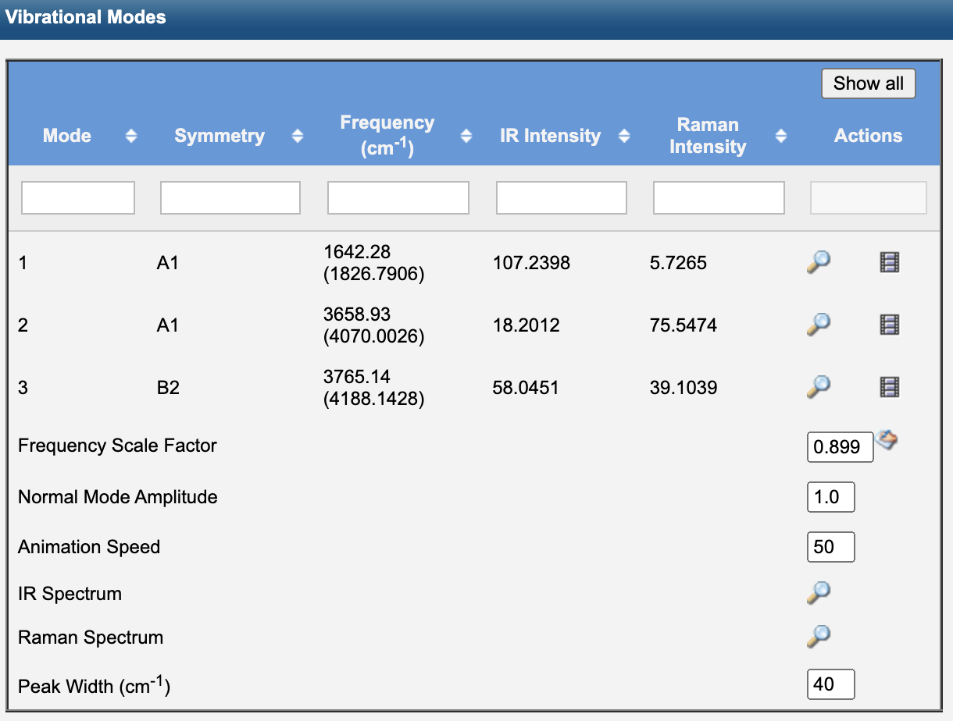
Vibrational modes
Calculated vibrational frequencies with and without scaling factors
Click here to visualise the specific vibration of the molecule at a given frequency
Calculated vibrational intensities

Slide 16
H₂O IR spectrum
Calculated vibrational frequencies with and without scaling factors
Click here to visualise the specific vibration of the molecule at a given frequency
Calculated vibrational intensities
Visualise the IR spectrum

Slide 17
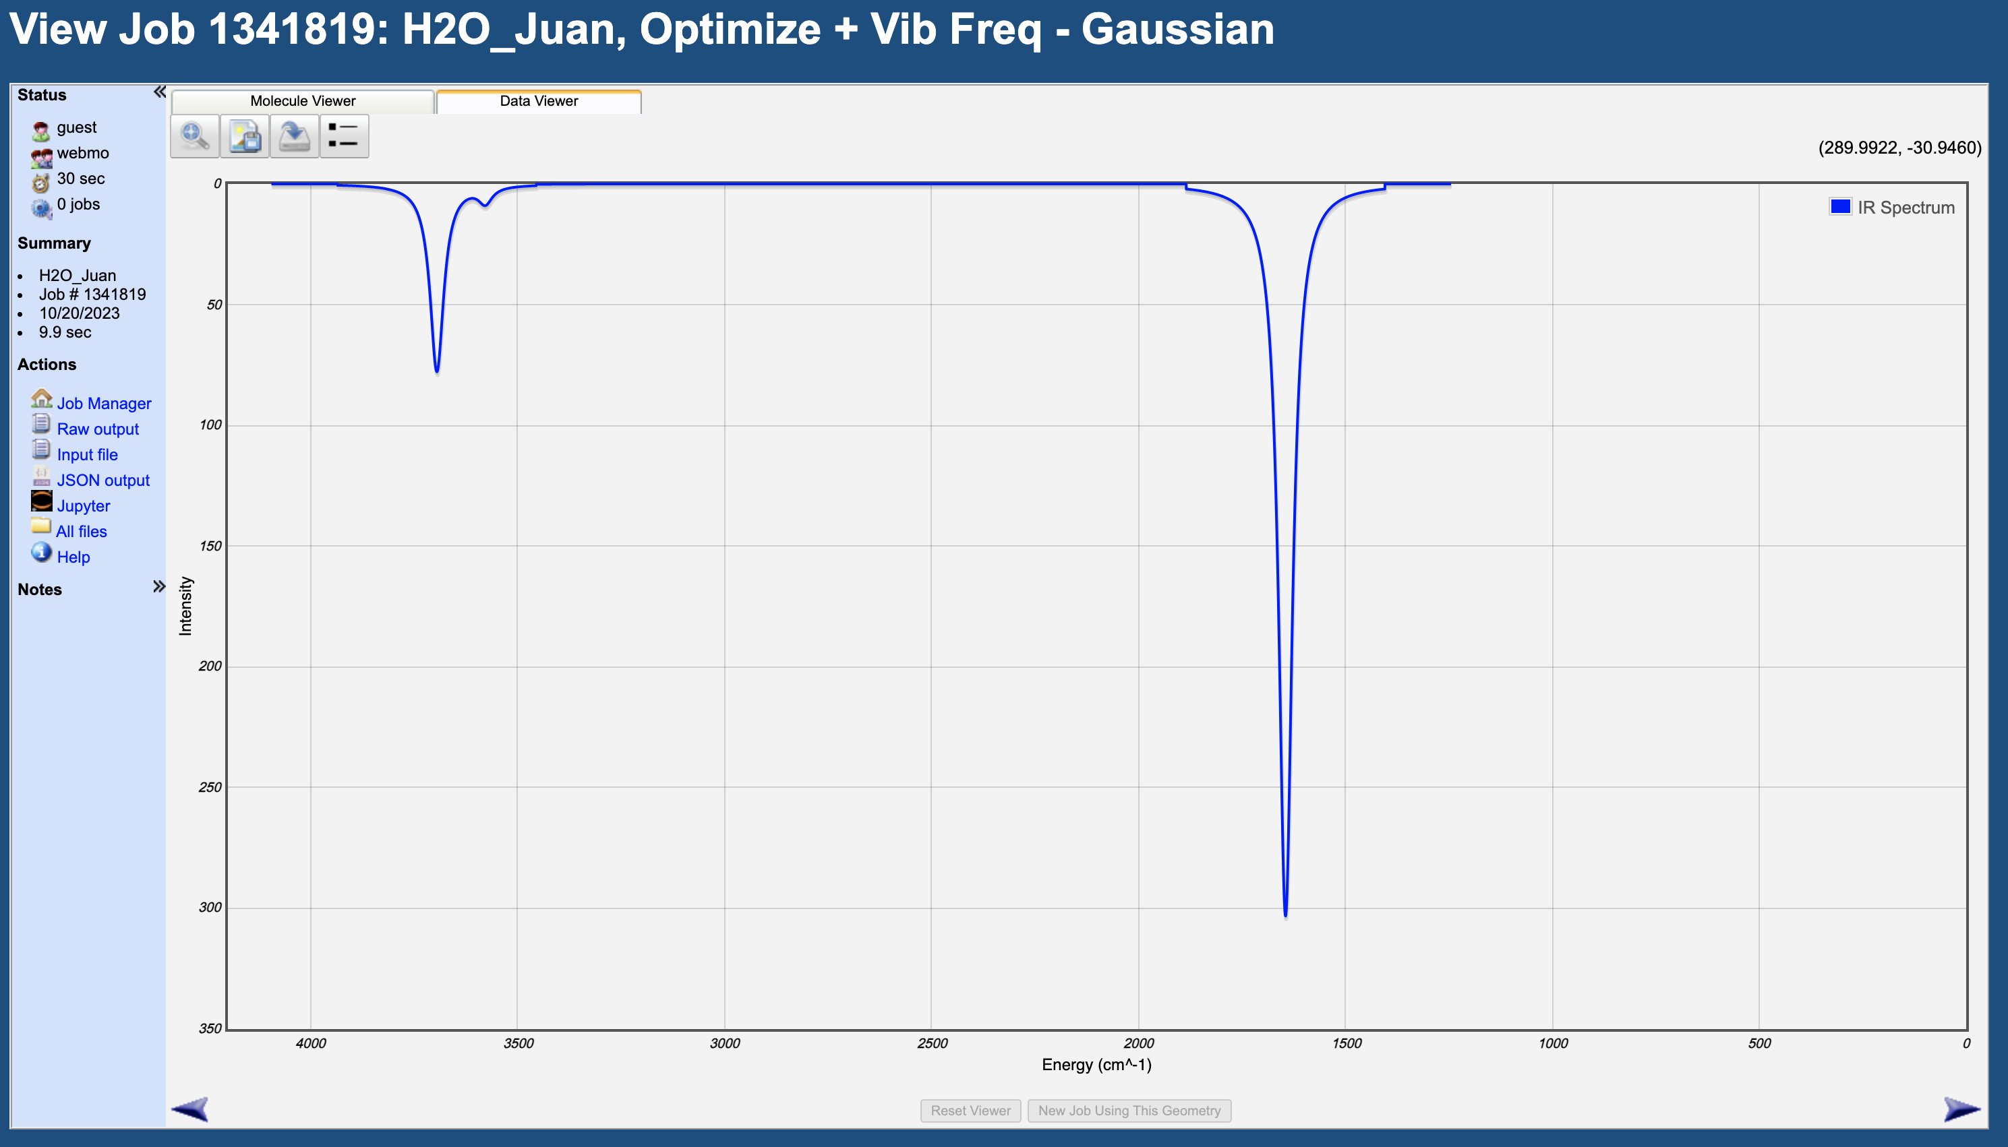
H₂O IR spectrum
Symmetric O-H stretch
Asymmetric O-H stretch
H-O-H bending

Slide 18
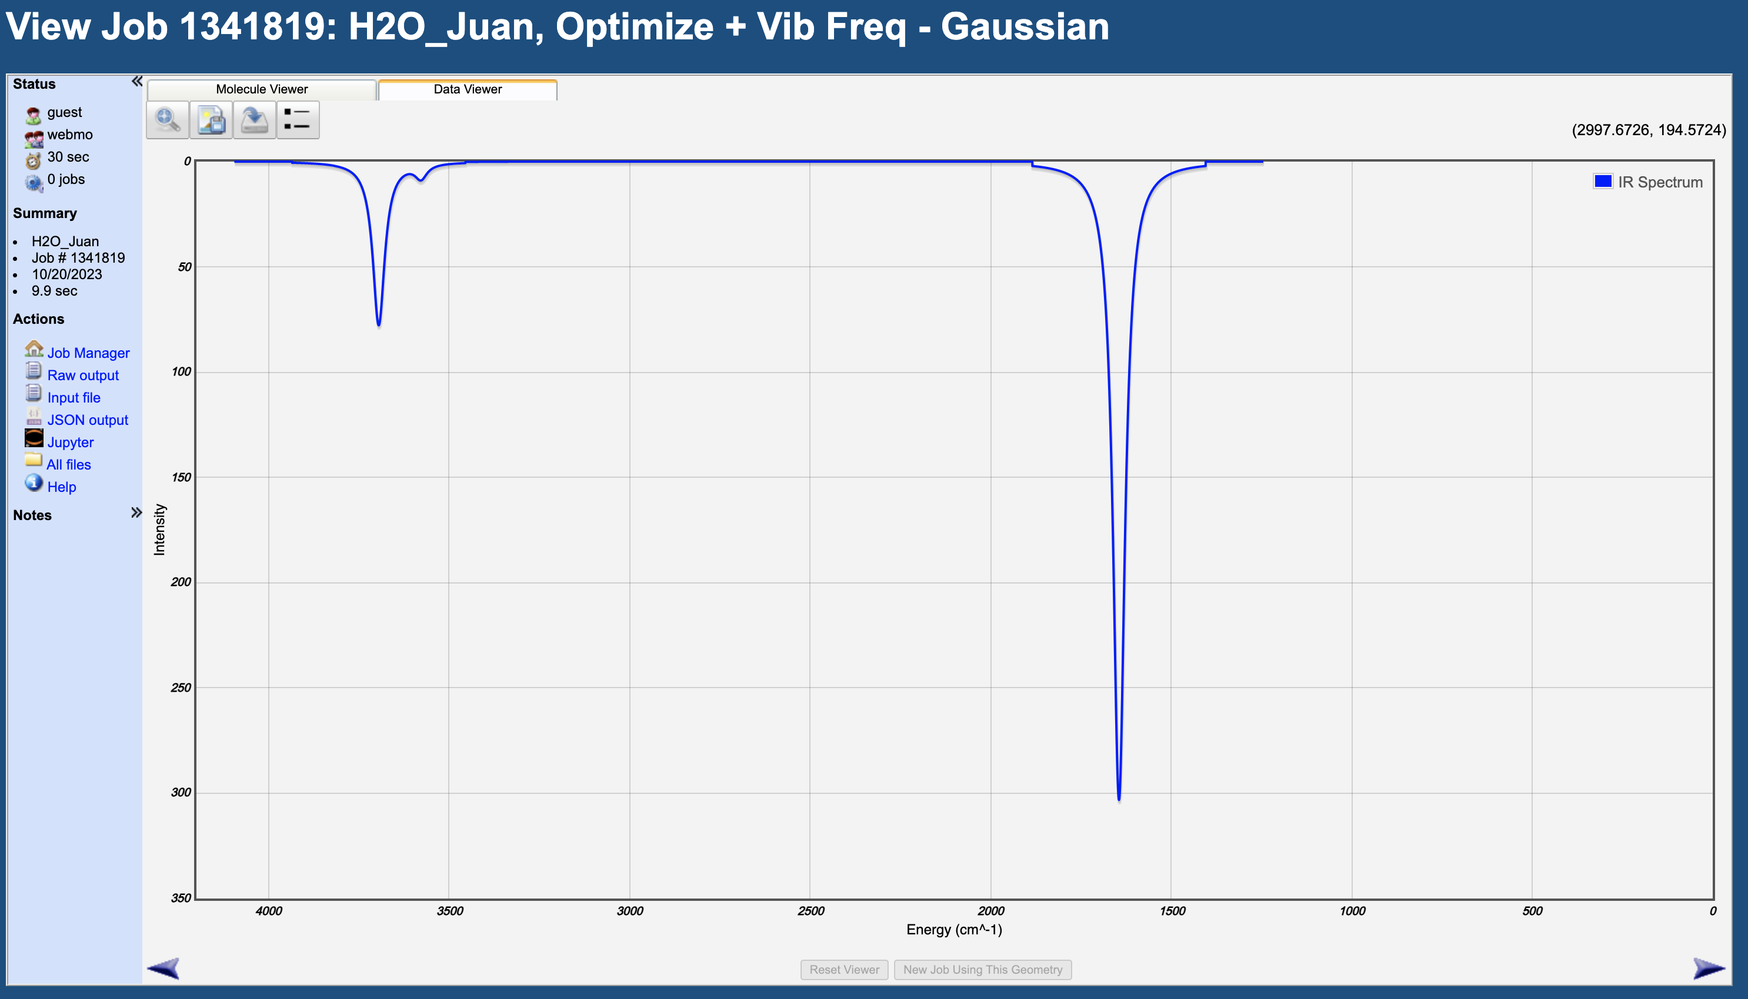
Saving the output file
Click Raw output. This will open a new window with the output file containing all the info from the calculation

Slide 19
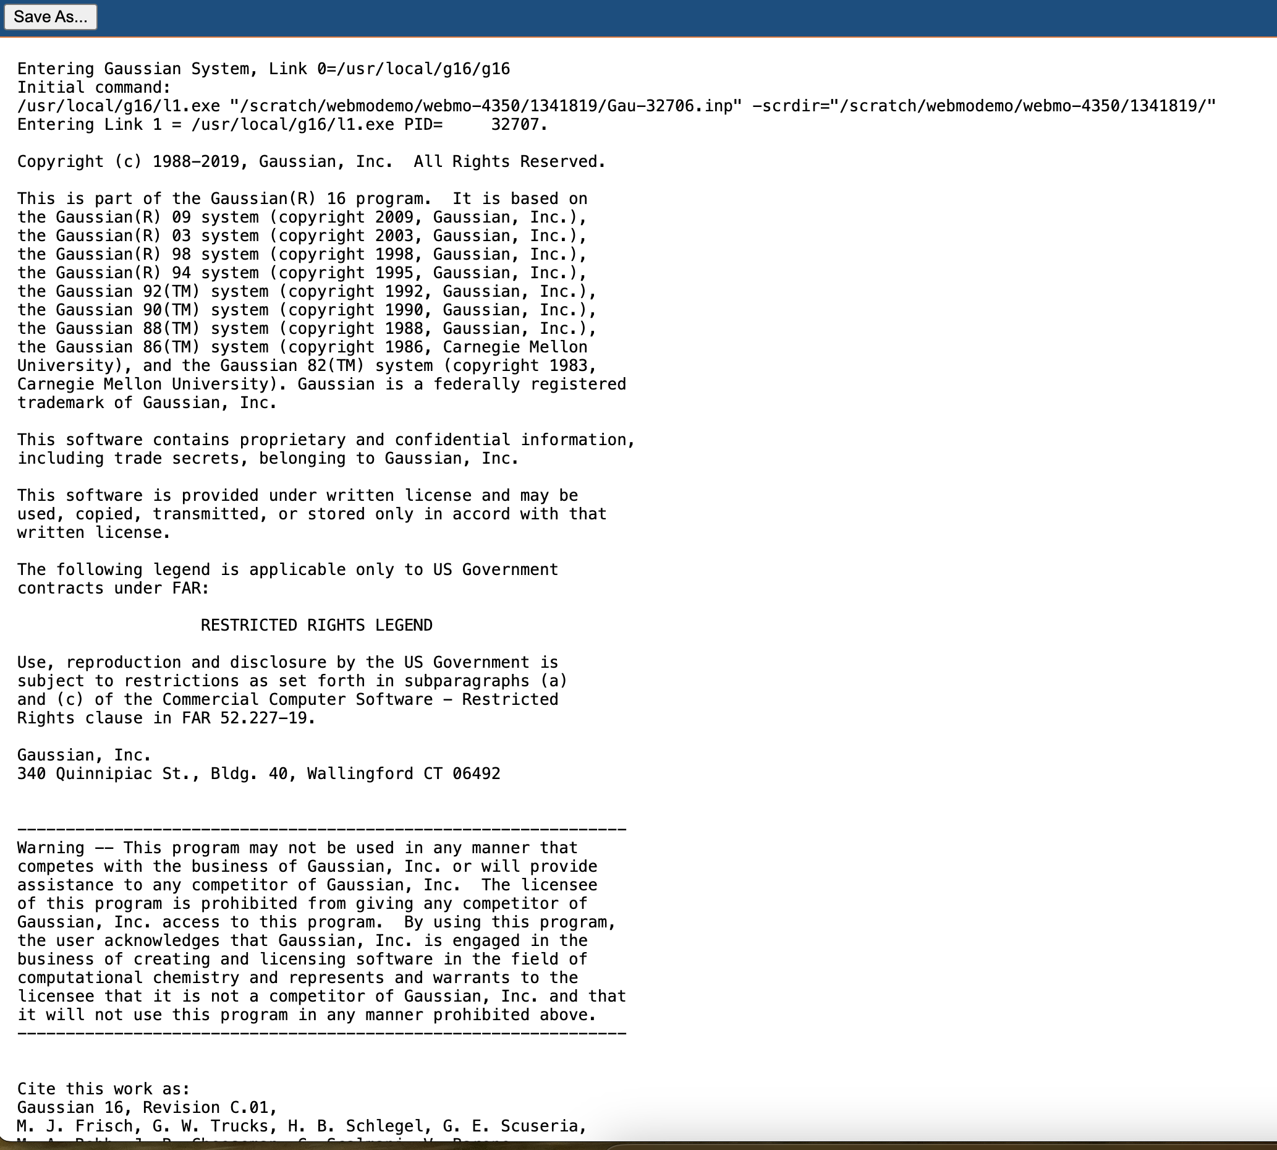
Saving the output file
Your new window will look like this one. Click Save As.. To save the output file. We will use this file later today

Slide 20
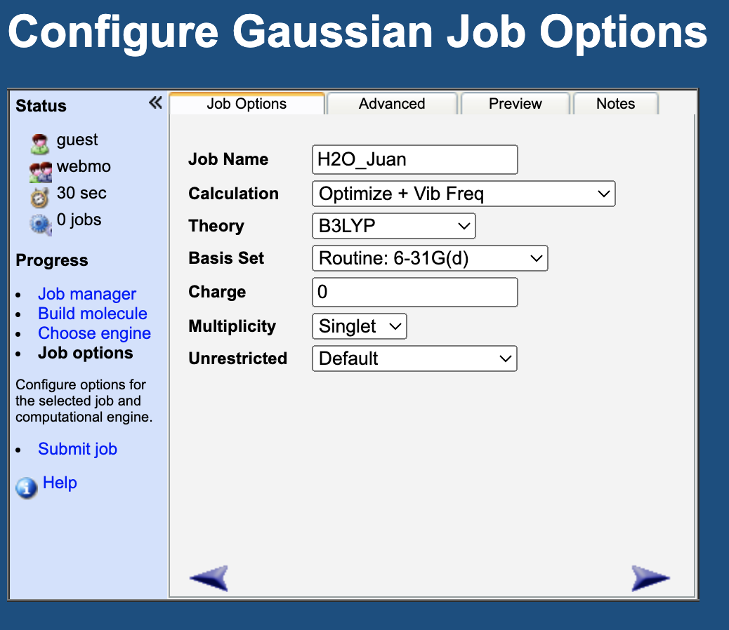
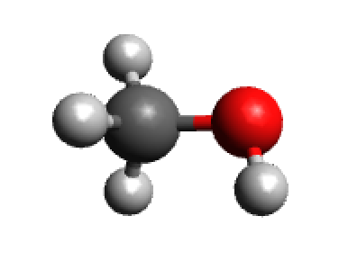
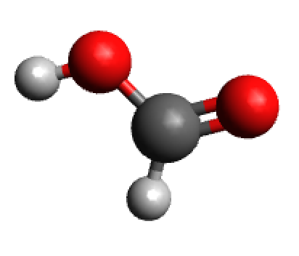
Your turn!
Following the instructions from this section, run vibrational frequency calculations for the molecules below. Save the output files. We will use them in the next activity.
Methanol (CH₃OH)
Formic Acid (CHCOOH)
Use these calculation settings

